Slide 1
SHOPBOLD
TEAM
Vinitha Mandari Aryanshi Dutt
Bhagyashree Swarna Sai Supriya

Slide 2
Project Overview
ShopBold is an Angular-based eCommerce platform designed to provide a seamless shopping experience.
It offers a responsive UI, secure transactions, and scalable architecture.

Slide 3
Technology Stack
Layer | Tools Used​
Frontend | Angular (Standalone Components)​
HTTP Requests | Angular HttpClientModule​
Backend | JSON Server
Testing | Jasmine​
Storage | localStorage​

Slide 4
Application Modules​
User Authentication
Product Catalog
Shopping Cart
Order Management
Payment Module

Slide 5
Key Features
User Registration and Data Storage
Browse products by category
View detailed product descriptions
Add items to cart
Adjust quantity and remove items
Proceed to payment and confirm orders

Slide 6
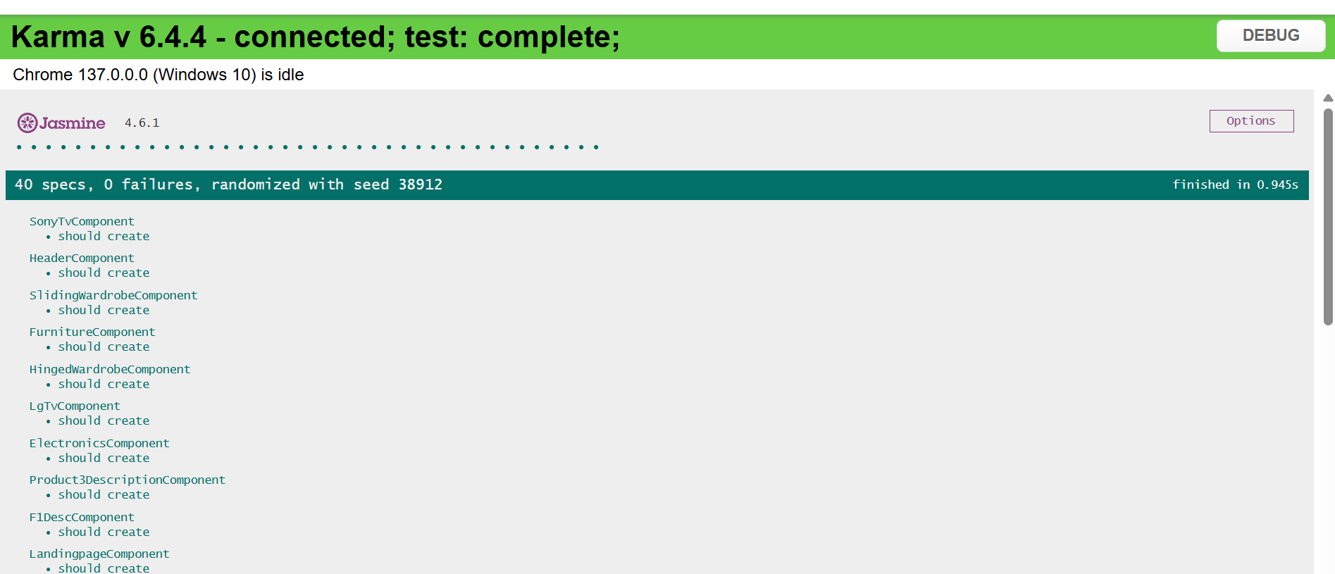
Unit Testing
Jasmine and Karma used for frontend testing
Test coverage includes components, services on: AppComponent, ContentComponent, HeaderComponent, CartComponent
All unit tests passed

Slide 7
Backend Data Structure
"orders": [
{
"id": "ad2d",
"cart": [
{
"name": "Apple iPhone 14 - 12GB",
"description": "\n Experience the power and elegance of the Apple iPhone 14 with 12GB RAM. ",
"price": 79999,
"image": "/Phone.png",
"quantity": 1
}
],
"total": 79999,
"paymentMethod": "cod",
"cardDetails": null,
"delivery": {
"fullName": "supriya",
"email": "asdf@gmail.com",
"phone": "1234567890",
"street": "Ranga Bomma Street, Lalpuram",
"city": "Guntur",
"state": "ANDHRA PRADESH",
"postalCode": "522017"
}
}
"users": [
{
"id": "62f9",
"name": "supriya",
"email": "supriya@gmail.com",
"mobile": "9515831560",
"password": "Supriya@123"
}

Slide 8
Core Functionalities
Authentication: User Registration and Login
Product Listing: Display products from db.json
Cart: Add/remove items, Calculates Total
Checkout: Validate cart and complete purchase

Slide 9
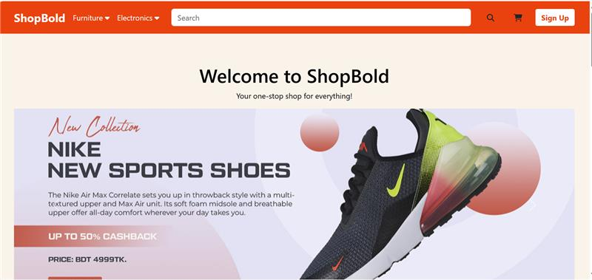
LANDING PAGE

Slide 10
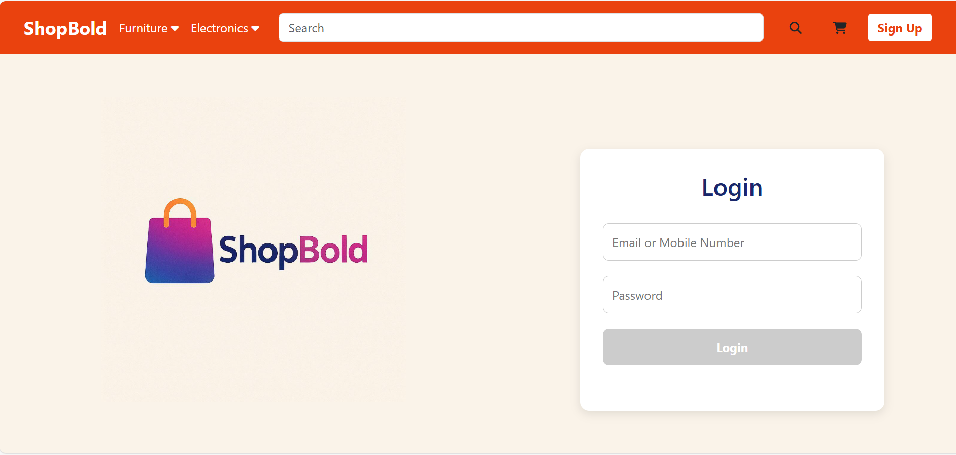
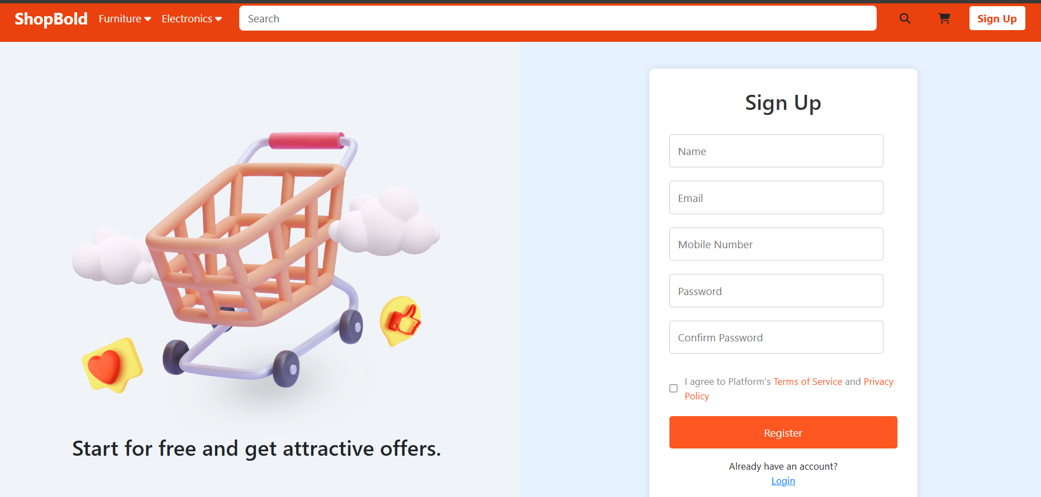
LOGIN AND SIGN UP

Slide 11
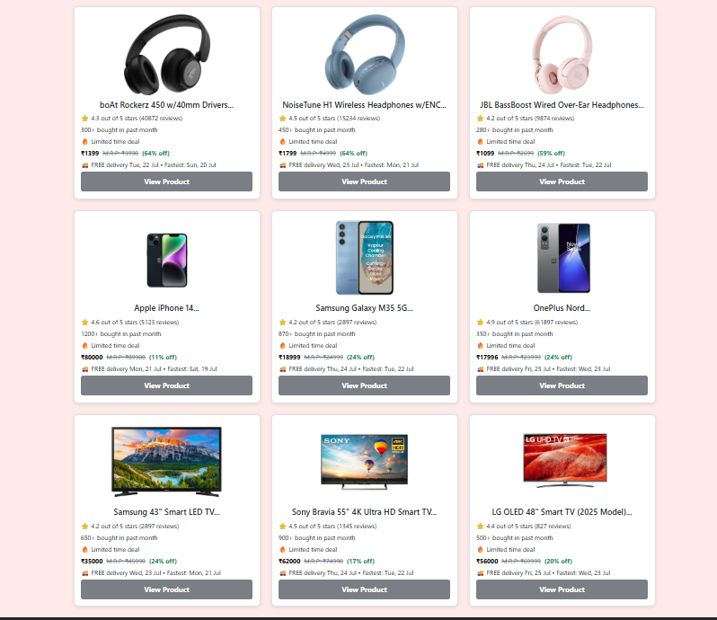
ELECTRONIC COMPONENTS

Slide 12
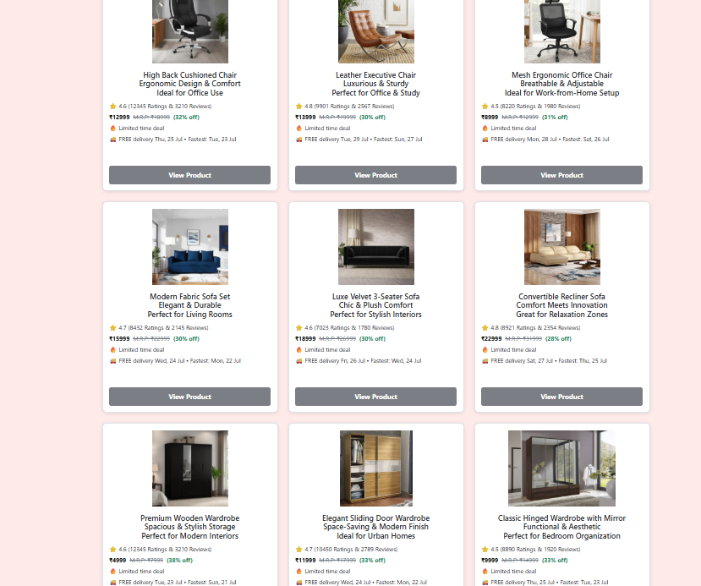
FURNITURE COMPONENTS

Slide 13
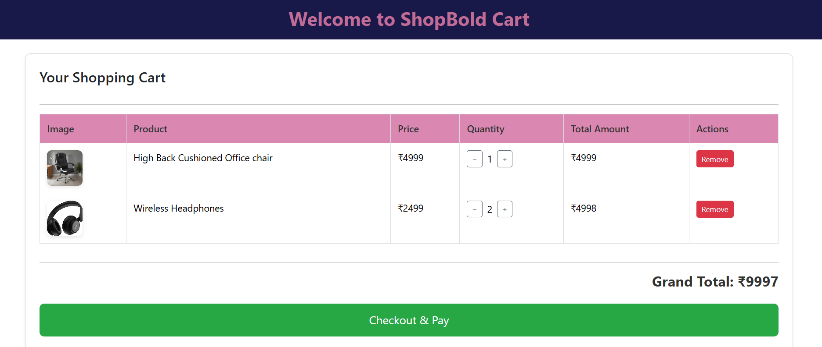
CART COMPONENT

Slide 14
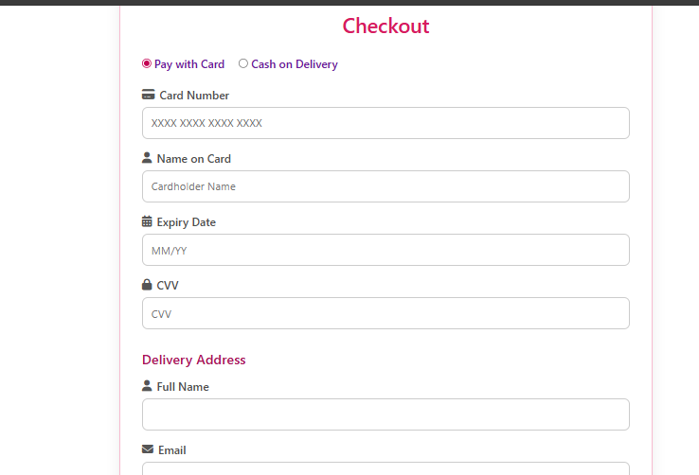
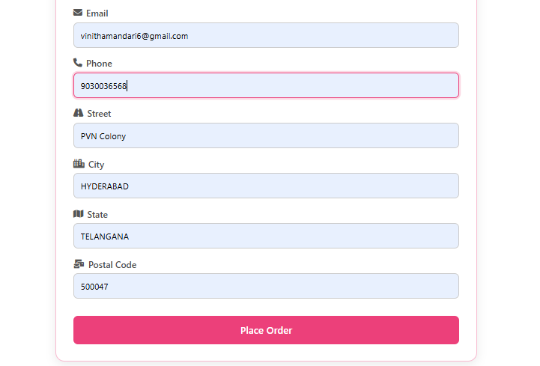
PAYMENT COMPONENT

Slide 15
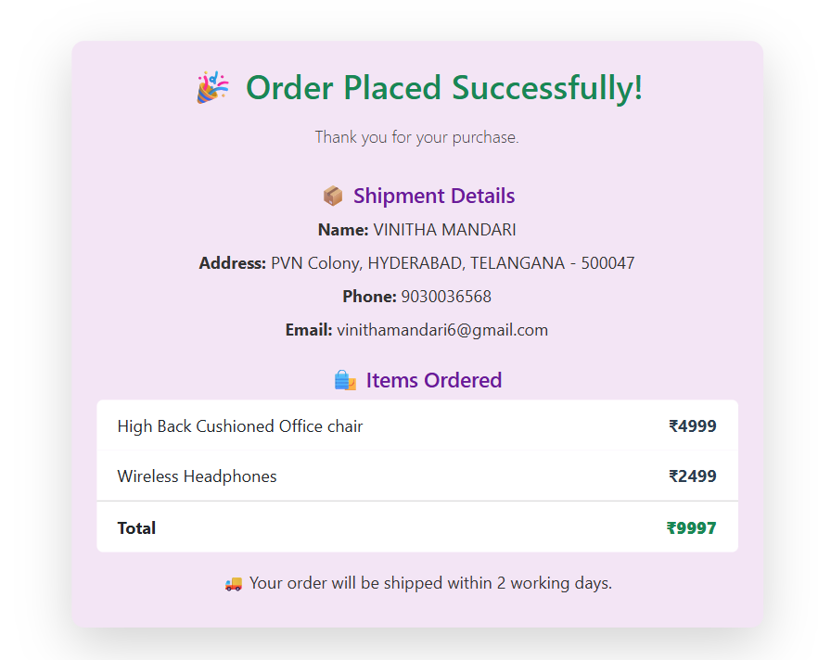
ORDER-CONFIRMATION

Slide 16
Achievements
Built a responsive frontend using Angular
Implemented dynamic data updates and validations
Developed basic CRUD operations for product management
Gained hands-on experience with Angular components and services

Slide 17
Future Enhancements
Add backend integration for full eCommerce functionality
Introduce product filtering and search features
Enhance UI with animations and better responsiveness
Integration with more payment gateways

Slide 18
THANK YOU

